Slide 1

SITA3008
INTERNET OF THINGS

Slide 2
UNIT I – INTRODUCTION TO IOT
UNIT II - ELEMENTS OF IOT
UNIT III - COMMUNICATION AND CONNECTIVE TECHNOLOGIES
UNIT IV - DATA ANALYTICS AND IOT PLATFORM
UNIT V - HANDS-ON PROJECTS

Slide 3
UNIT III
IoT Communication Model
Cloud computing in IoT
IoT in cloud architecture
Logging on to cloud, Selecting and Creating cloud service
cloud based IoT platforms - IBM Watson, Google cloud

Slide 4
What is IoT?
Internet of Things (IoT) is a new techno-commercial paradigm envisioned as a dynamic global network of IP-enabled objects, machines, devices, and appliances capable of interacting with each other via Intranet/ Internet.

Slide 5
1. IoT Communication Model

Slide 6
Communication Models in IOT
The term of internet of things (IoT) communication offered by Internet protocols . Many of the devices often called as smart objects operated by humans as components in buildings or vehicles, or are spread out in the environment.

Slide 7
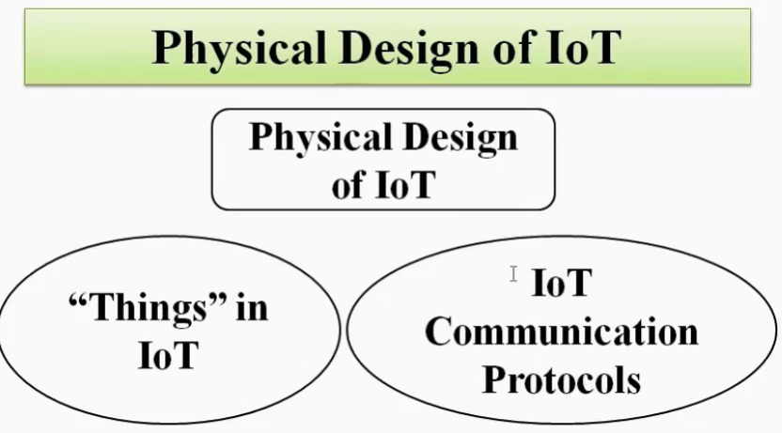

Slide 8
Types of Communication Model
Device-to-Device communication model
Device-to-Cloud communication model
Device-to-Gateway model
Back-end Data-sharing model

Slide 9
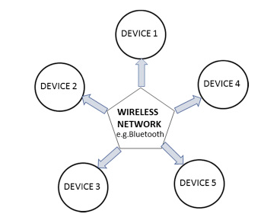
Device-to-Device communication model

Slide 10
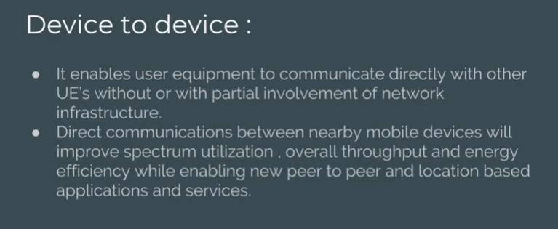

Slide 11
Attacks in Device to Device Communication
Credentials stealing from the firmware
Sensitive information disclosure
No proper updating mechanism of firmware
DoS Attacks
Buffer-overflow attacks

Slide 12
Security - Device to Device Communication
Evaluate hardware components, firmware, software, communications protocols
Try to Make the signed Firmware, software and hash your binaries.
Implement the machine to machine authentication securely.
Get the feedback from the clients to improve the device security levels

Slide 13
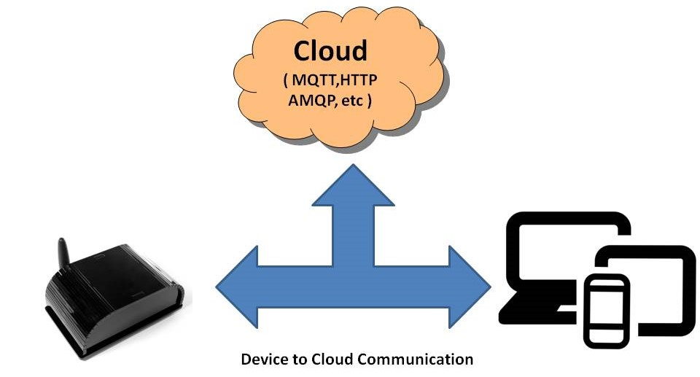
Device-to-Cloud Communications

Slide 14
Cloud Protocols
Protocols | AMQP | MQTT | XMPP | CoAP
Transport | TCP/IP | TCP/IP | TCP/IP | UDP/IP
Message pattern | Publish — Subscribe | Publish — Subscribe | Point — Point Publish –Subscribe | Request – Response

Slide 15
Attacks in Device to Device Communication
SQL injection
Cross-site Scripting
Username and password enumeration attacks
MITM attacks
Man in the Cloud (MiTC) attacks

Slide 16
Security - Device to Device Communication
Check all cloud interfaces are reviewed for security vulnerabilities (e.g. API interfaces and cloud-based web interfaces)
Make sure cloud-based web interface not having weak passwords
Ensure that any cloud-based web interface has an account lockout mechanism
Implement two-factor authentication for cloud-based web interfaces
Maintain transport encryption
Ensure that any cloud-based web interface has been tested for XSS, SQLi and CSRF vulnerabilities.

Slide 17
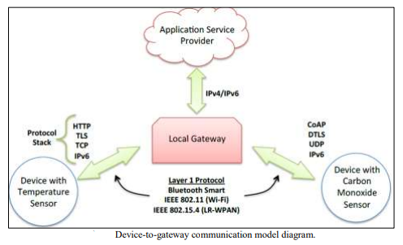
Device-to-Gateway communication model

Slide 18
Attacks in Device to Gateway Communication
Denial-of-Service attacks & DDoS attacks,
HTTP floods,
SQL injections,
cross-site scripting,
parameter tampering,
Slowloris attacks

Slide 19
Security - Device to Gateway Communication
Web application firewalls (WAFs)
Secure web gateway services

Slide 20
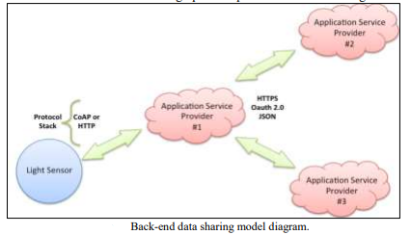
Back-End Data-Sharing communication model

Slide 21
2. Cloud Computing in IoT

Slide 22
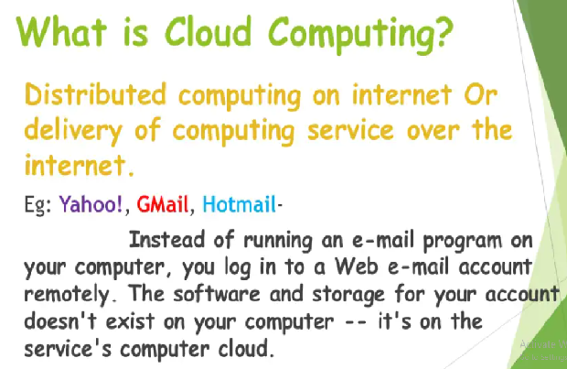
IOT in Cloud Computing

Slide 23
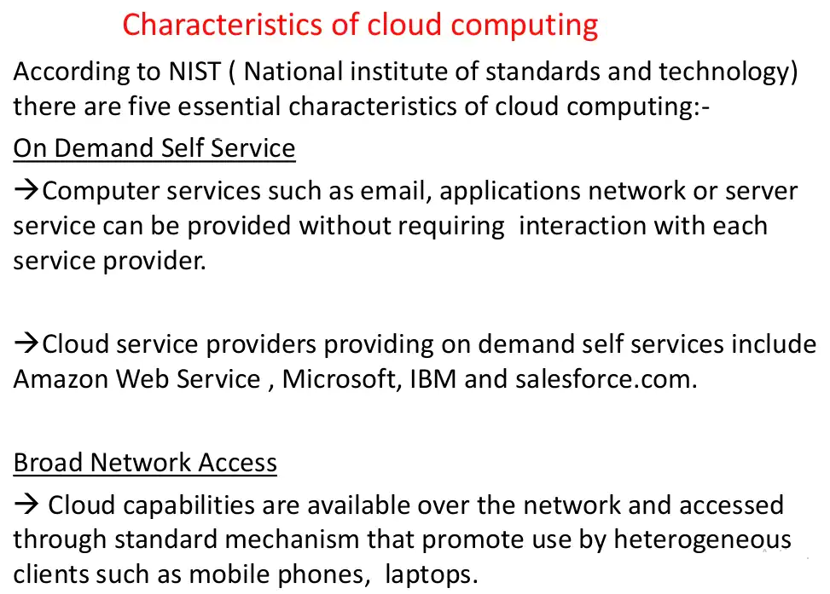

Slide 24
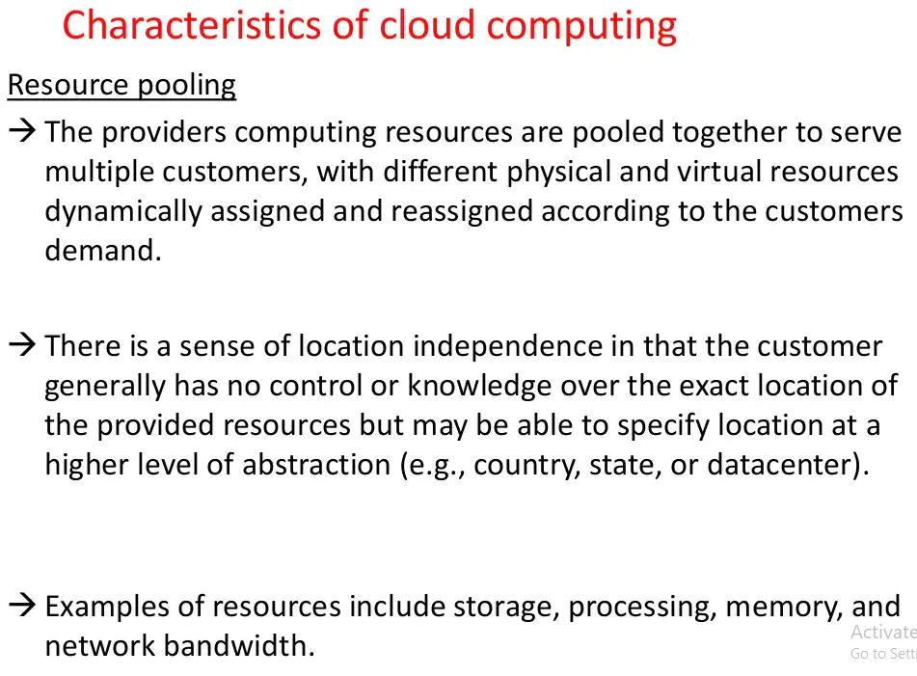

Slide 25
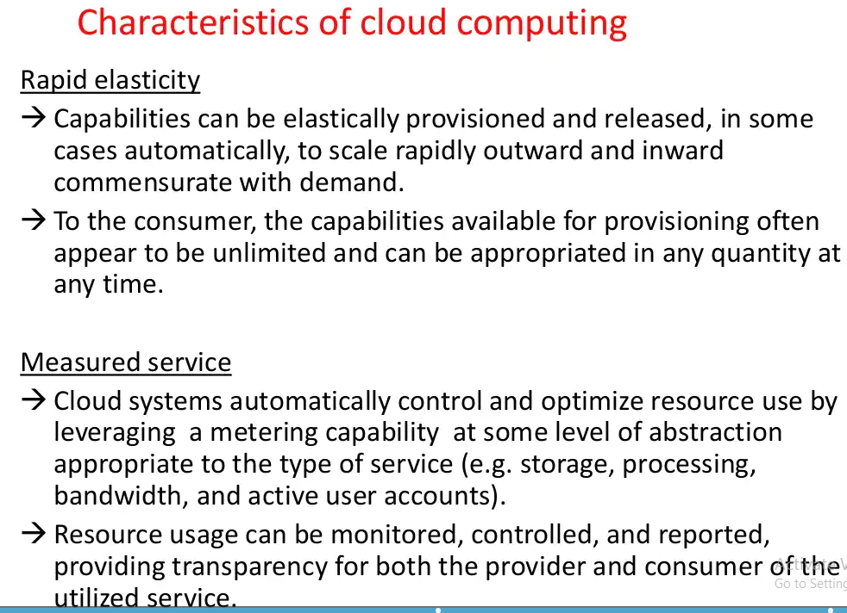

Slide 26
IoT/cloud Service
Infrastructure-as-a-Service (IaaS) IoT/Clouds
Platform-as-a-Service (PaaS) IoT/Clouds
Software-as-a-Service (SaaS) IoT/Clouds

Slide 27
Infrastructure-as-a-Service (IaaS) IoT/Clouds
These services provide the means for accessing sensors and actuator in the cloud.
The associated business model involves the IoT/Cloud provide to act either as data or sensor provider.
IaaS services for IoT provide access control to resources as a prerequisite for the offering of related pay-as-you-go services.
IaaS service - Amazon’s Elastic Compute Cloud (EC2)

Slide 28
Platform as a Service (PaaS) IoT/Clouds
PaaS provides development environments for creating cloud-ready business applications.
It provides a deeper set of capabilities comparing to IaaS, including development, middleware, and deployment capabilities.
PaaS services create and encourage deep ecosystem of partners who commit to this environment.
PaaS services - Google’s App Engine and Microsoft’s Azure cloud environment

Slide 29
Software as a Service (SaaS) IoT/Clouds
SaaS services enable access to purpose-built business applications in the cloud.
Such services provide the pay-go-go, reduced CAPEX and elastic properties of cloud computing infrastructures.

Slide 30
Cloud services can be offered through infrastructures
Publicly accessible (i.e. public cloud services),
Privately owned infrastructures (i.e. private cloud services).
Both public and private clouds -hybrid cloud services.

Slide 31
Benefits of IoT/Cloud
Communication
Storage
Process Capabilities
Scope
New Abilities
New Models

Slide 32
3. Cloud Architecture for IoT

Slide 33
The cloud components of IoT architecture are positioned within a three-tier architecture pattern comprising
Edge tiers,
Platform tiers and
Enterprise tiers,

Slide 34
Layers of Cloud Architecture
The user layer is independent of any specific network domain. It may be in or outside any specific domain.
The proximity network domain has networking capabilities that typically extend the public network domain.
The devices (including sensor/actuator, firmware and management agent) and the physical entity are part of the proximity network domain.
The devices communicate for both data flow and control flow either via an IoT Gateway and edge services or directly over the public network via edge services.

Slide 35
The public network and enterprise network domains contain data sources that feed the entire architecture.
Data sources include traditional systems of record from the enterprise as well as new sources from Internet of Things (IoT).
The public network includes communication with peer clouds.

Slide 36
The provider cloud captures data from devices, peer cloud services and other data sources (for example Weather services).
It can use integration technologies or stream processing to transform, filter and analyse this data in real time and it can store the data into repositories where further analytics can be performed.
This processing, which can be augmented with the use of Cognitive and Predictive analytics, is used to generate Actionable Insights.
These insights are used by users and enterprise applications and can also be used to trigger actions to be performed by IoT Actuators. All of this needs to be done in a secure and governed environment.

Slide 37
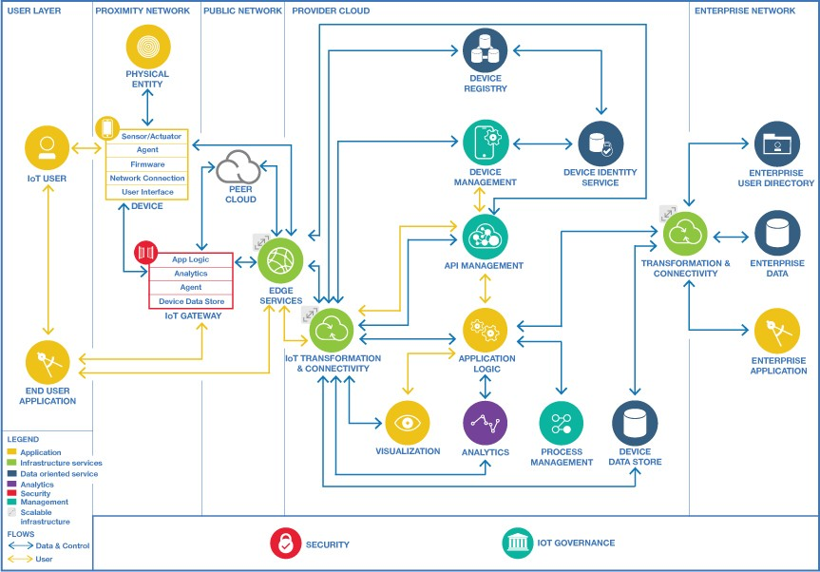

Slide 38
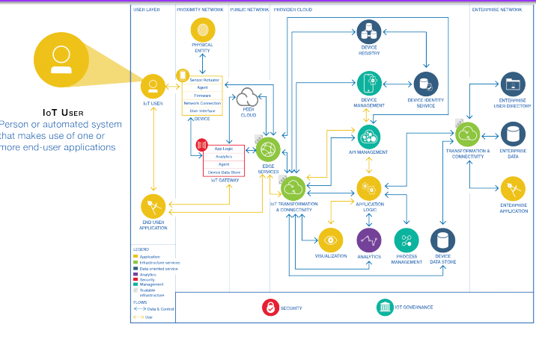

Slide 39
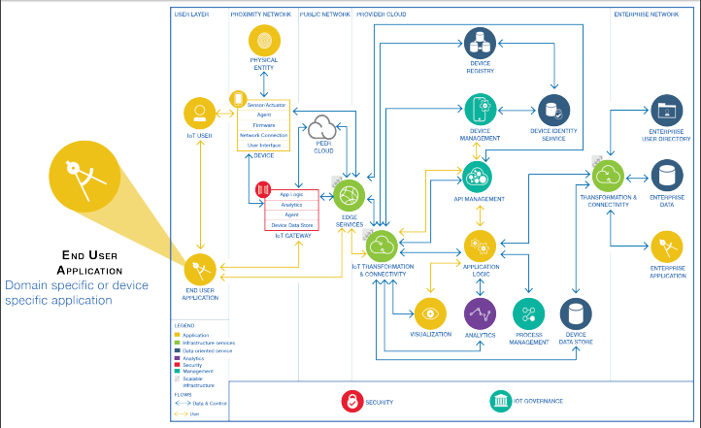

Slide 40
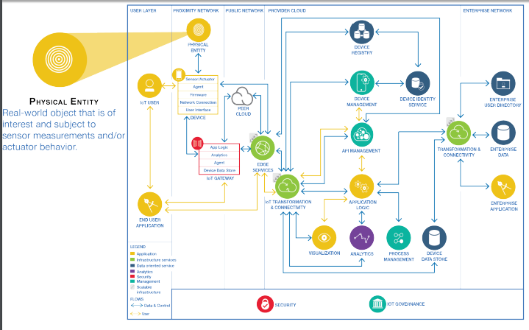

Slide 41
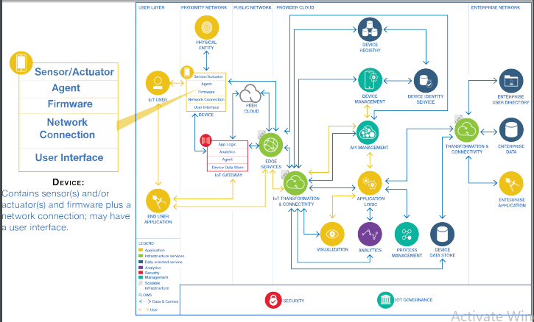

Slide 42
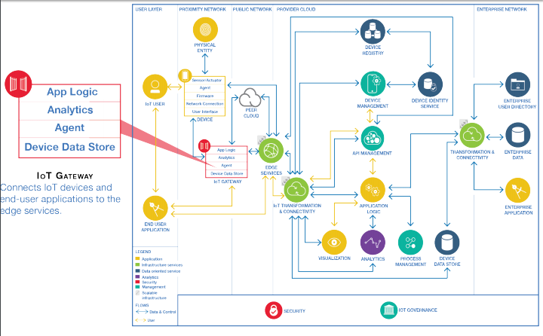

Slide 43
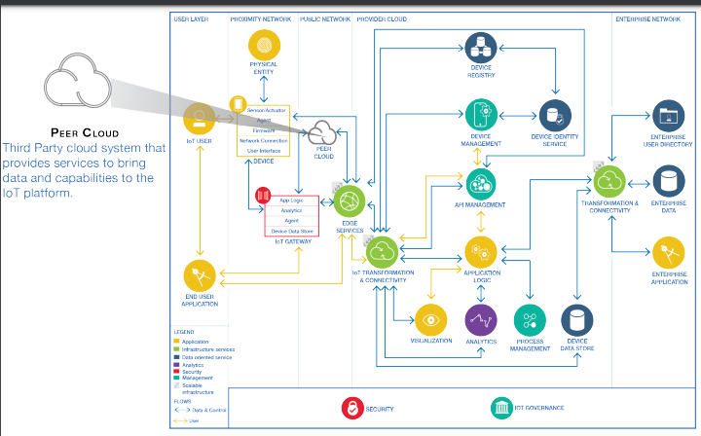

Slide 44
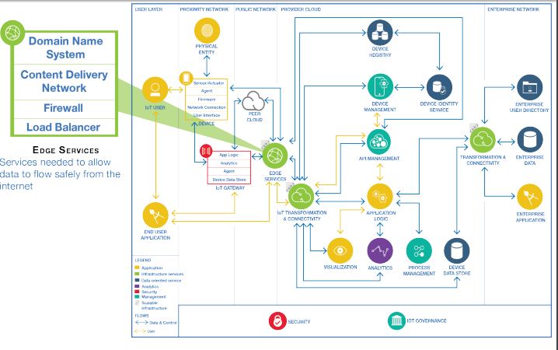

Slide 45
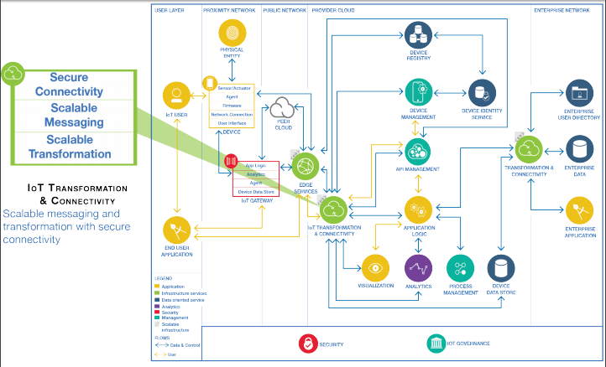

Slide 46
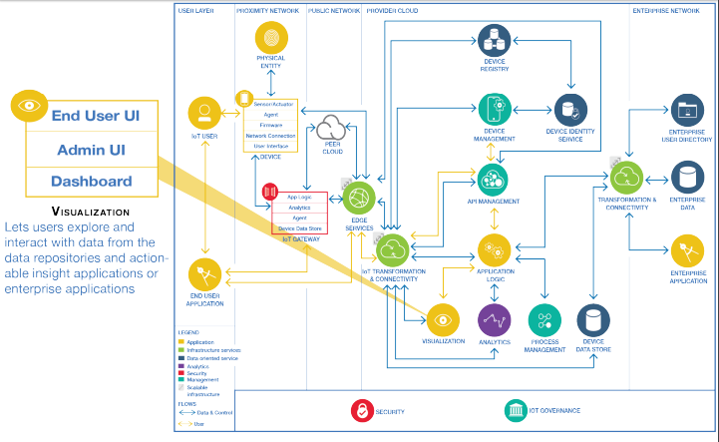

Slide 47
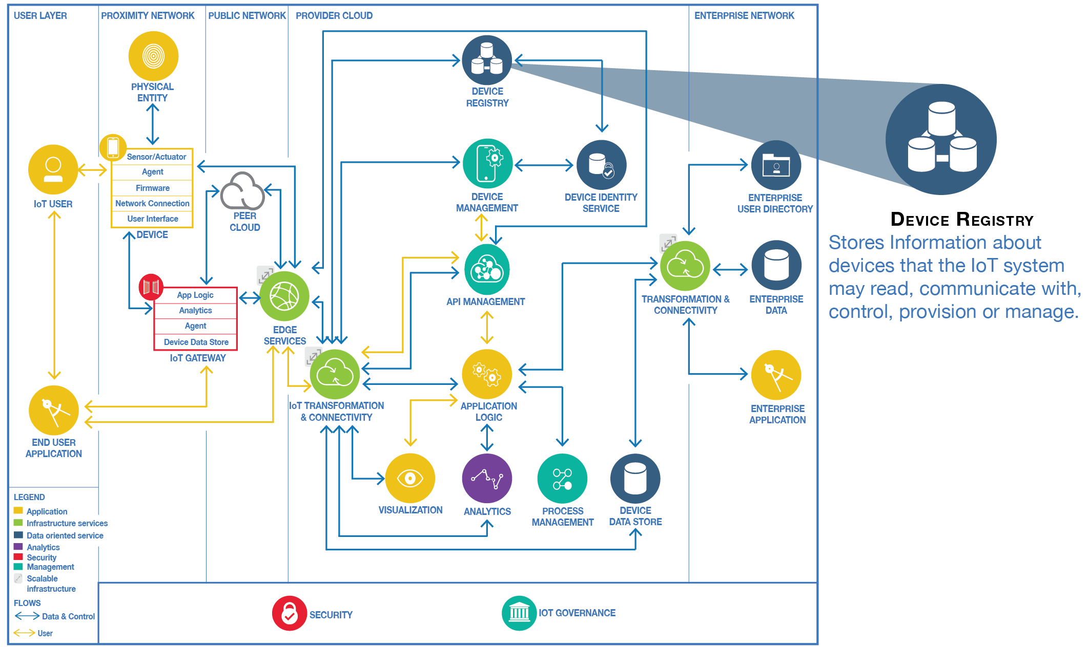

Slide 48
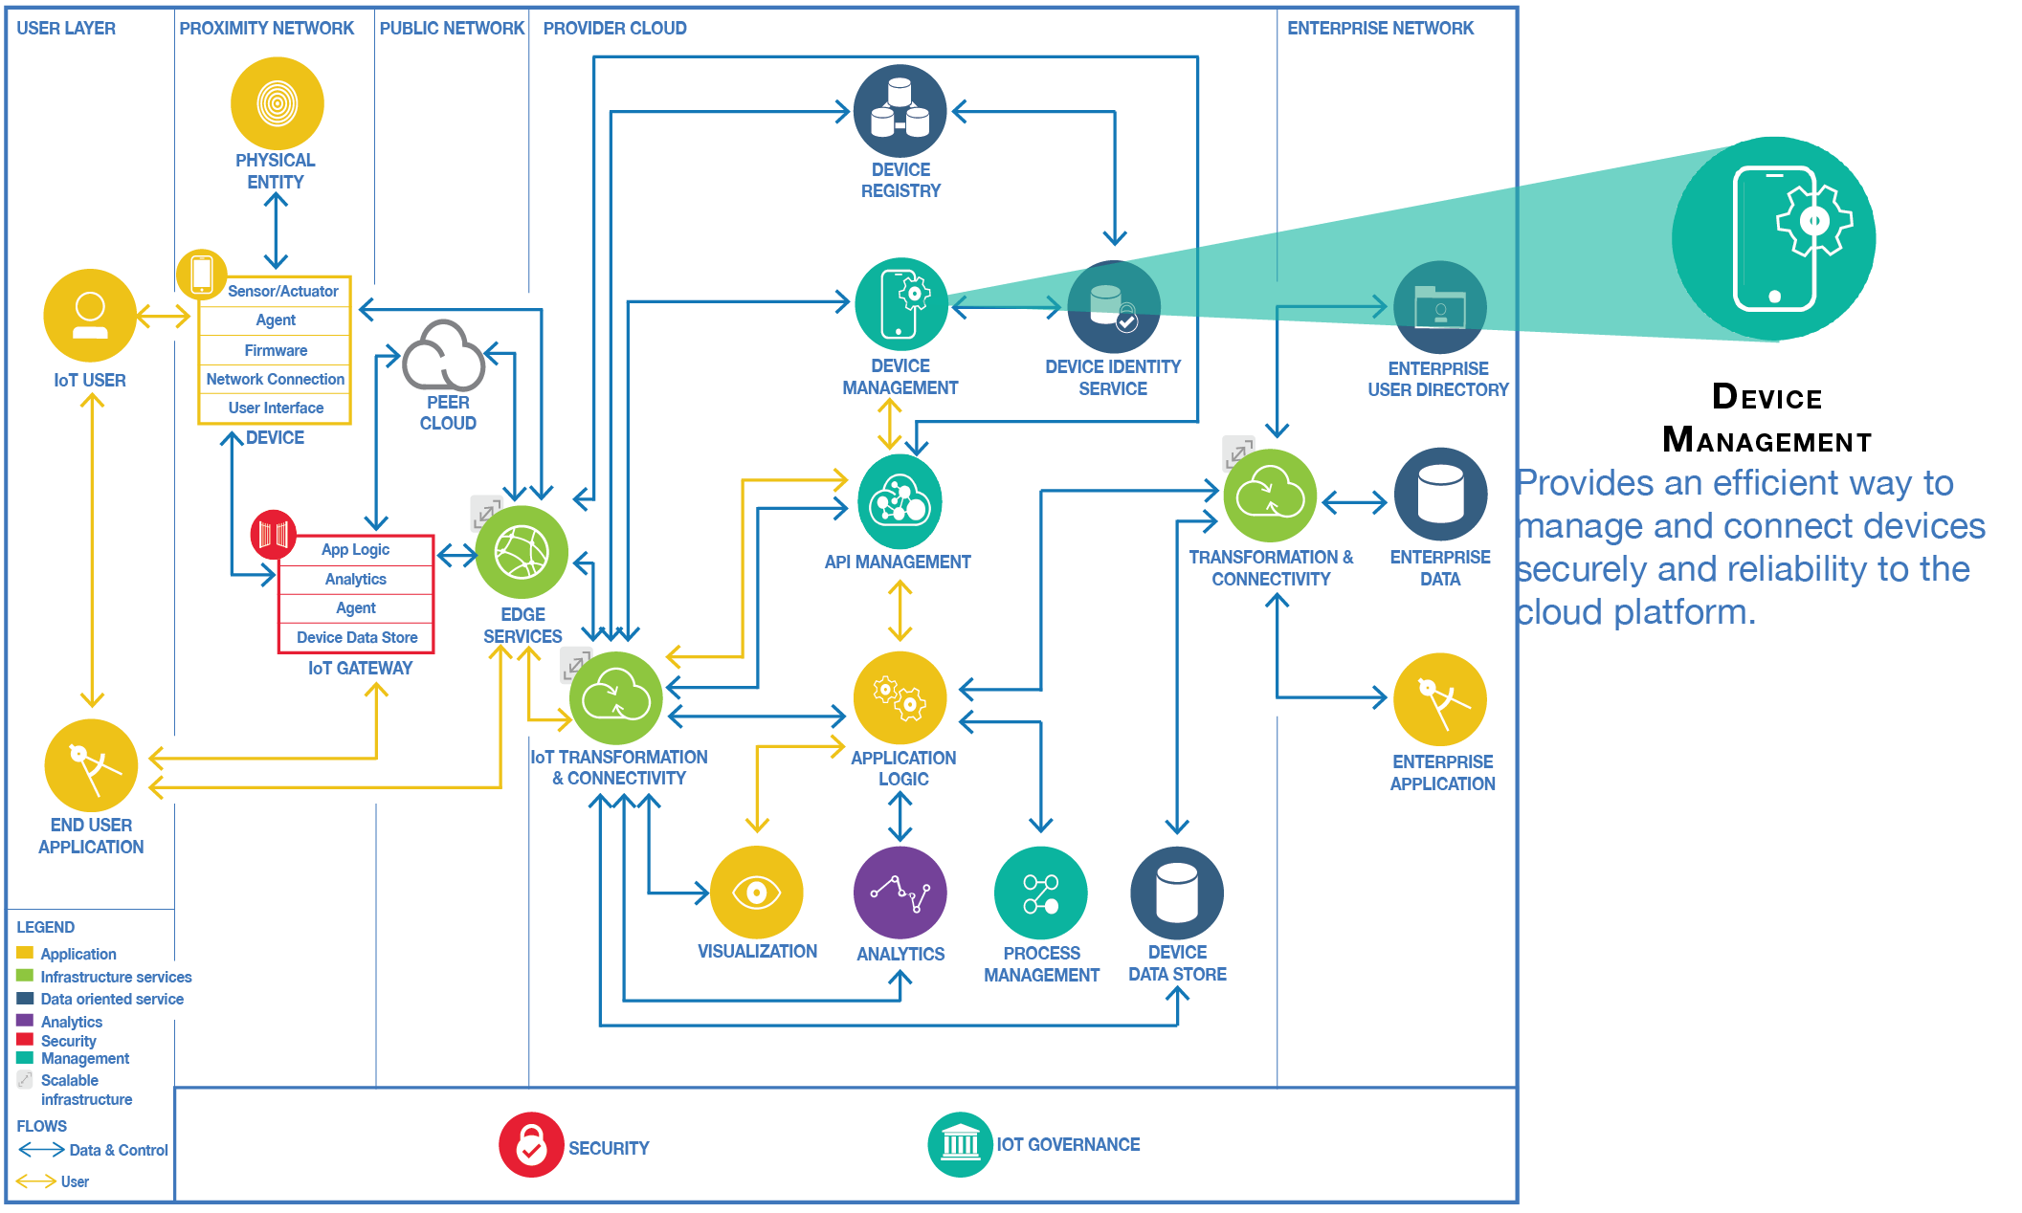

Slide 49
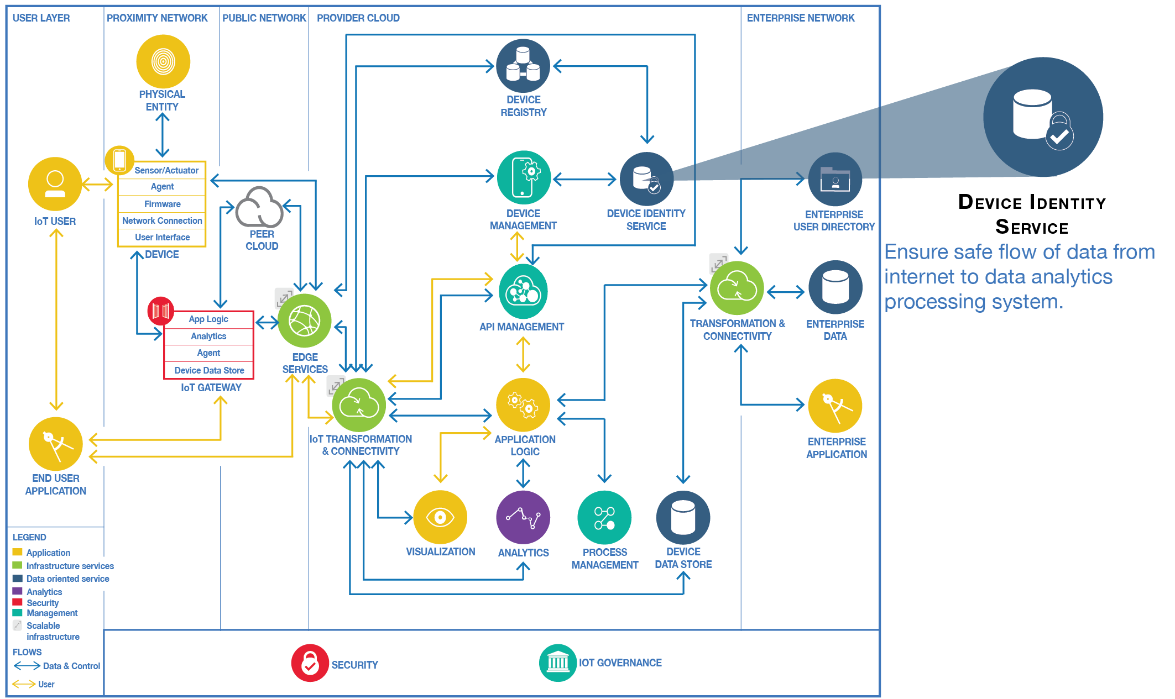

Slide 50
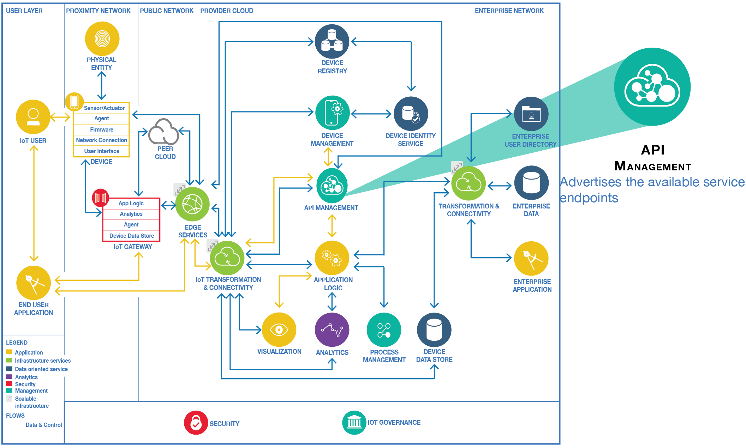

Slide 51
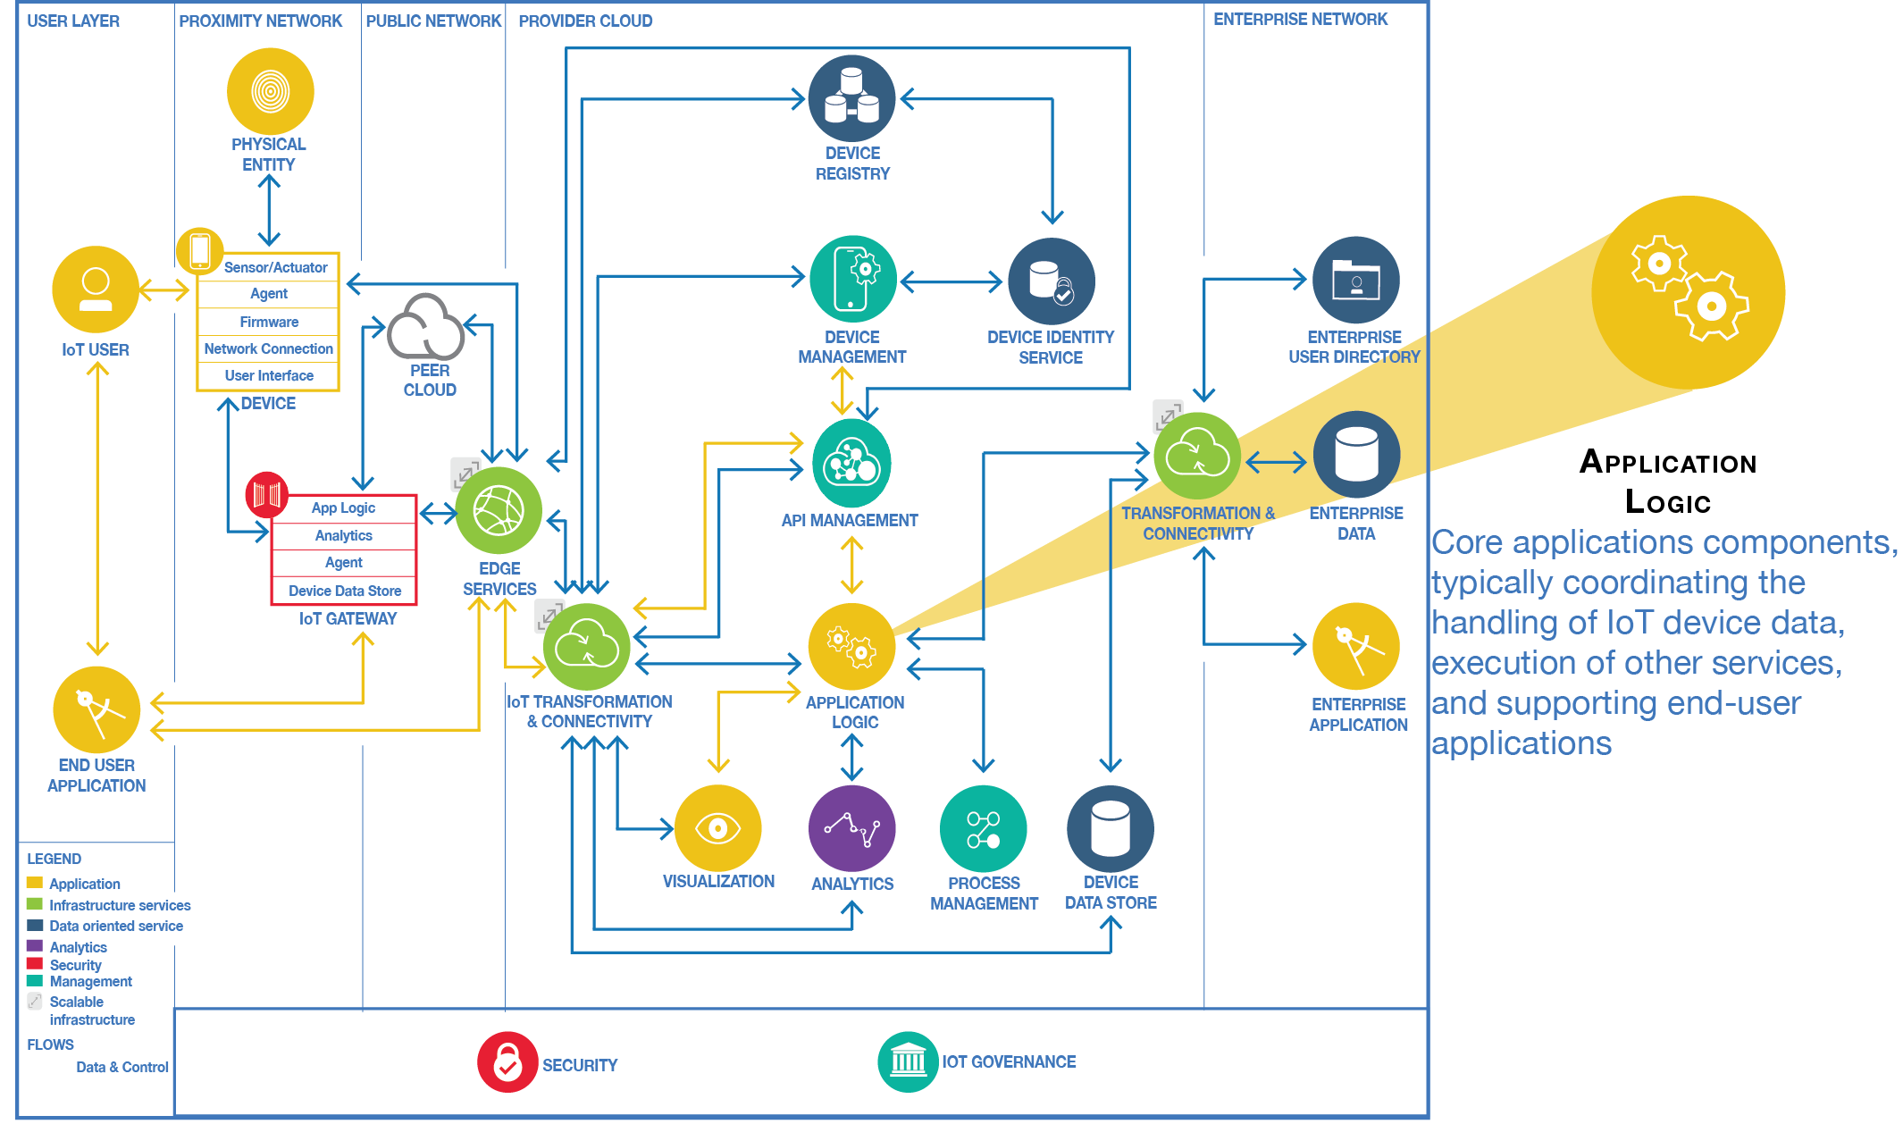

Slide 52
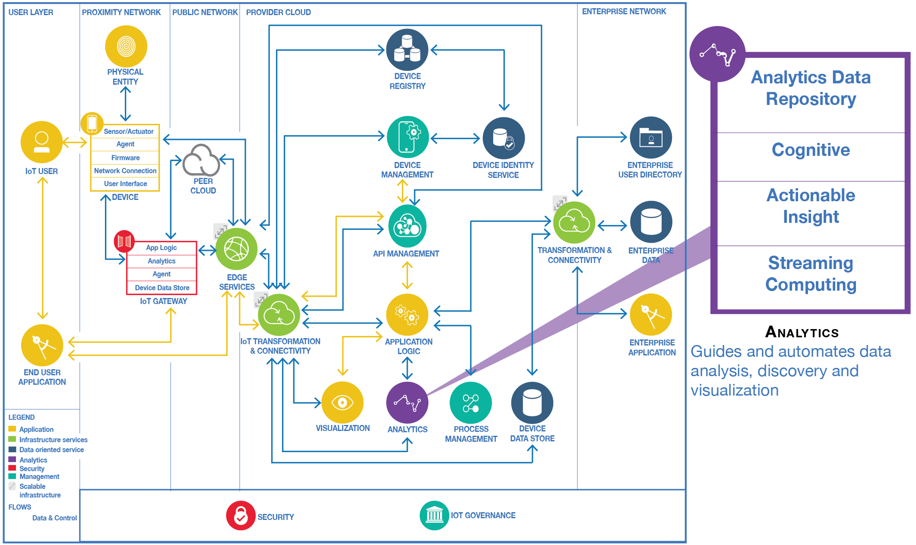

Slide 53
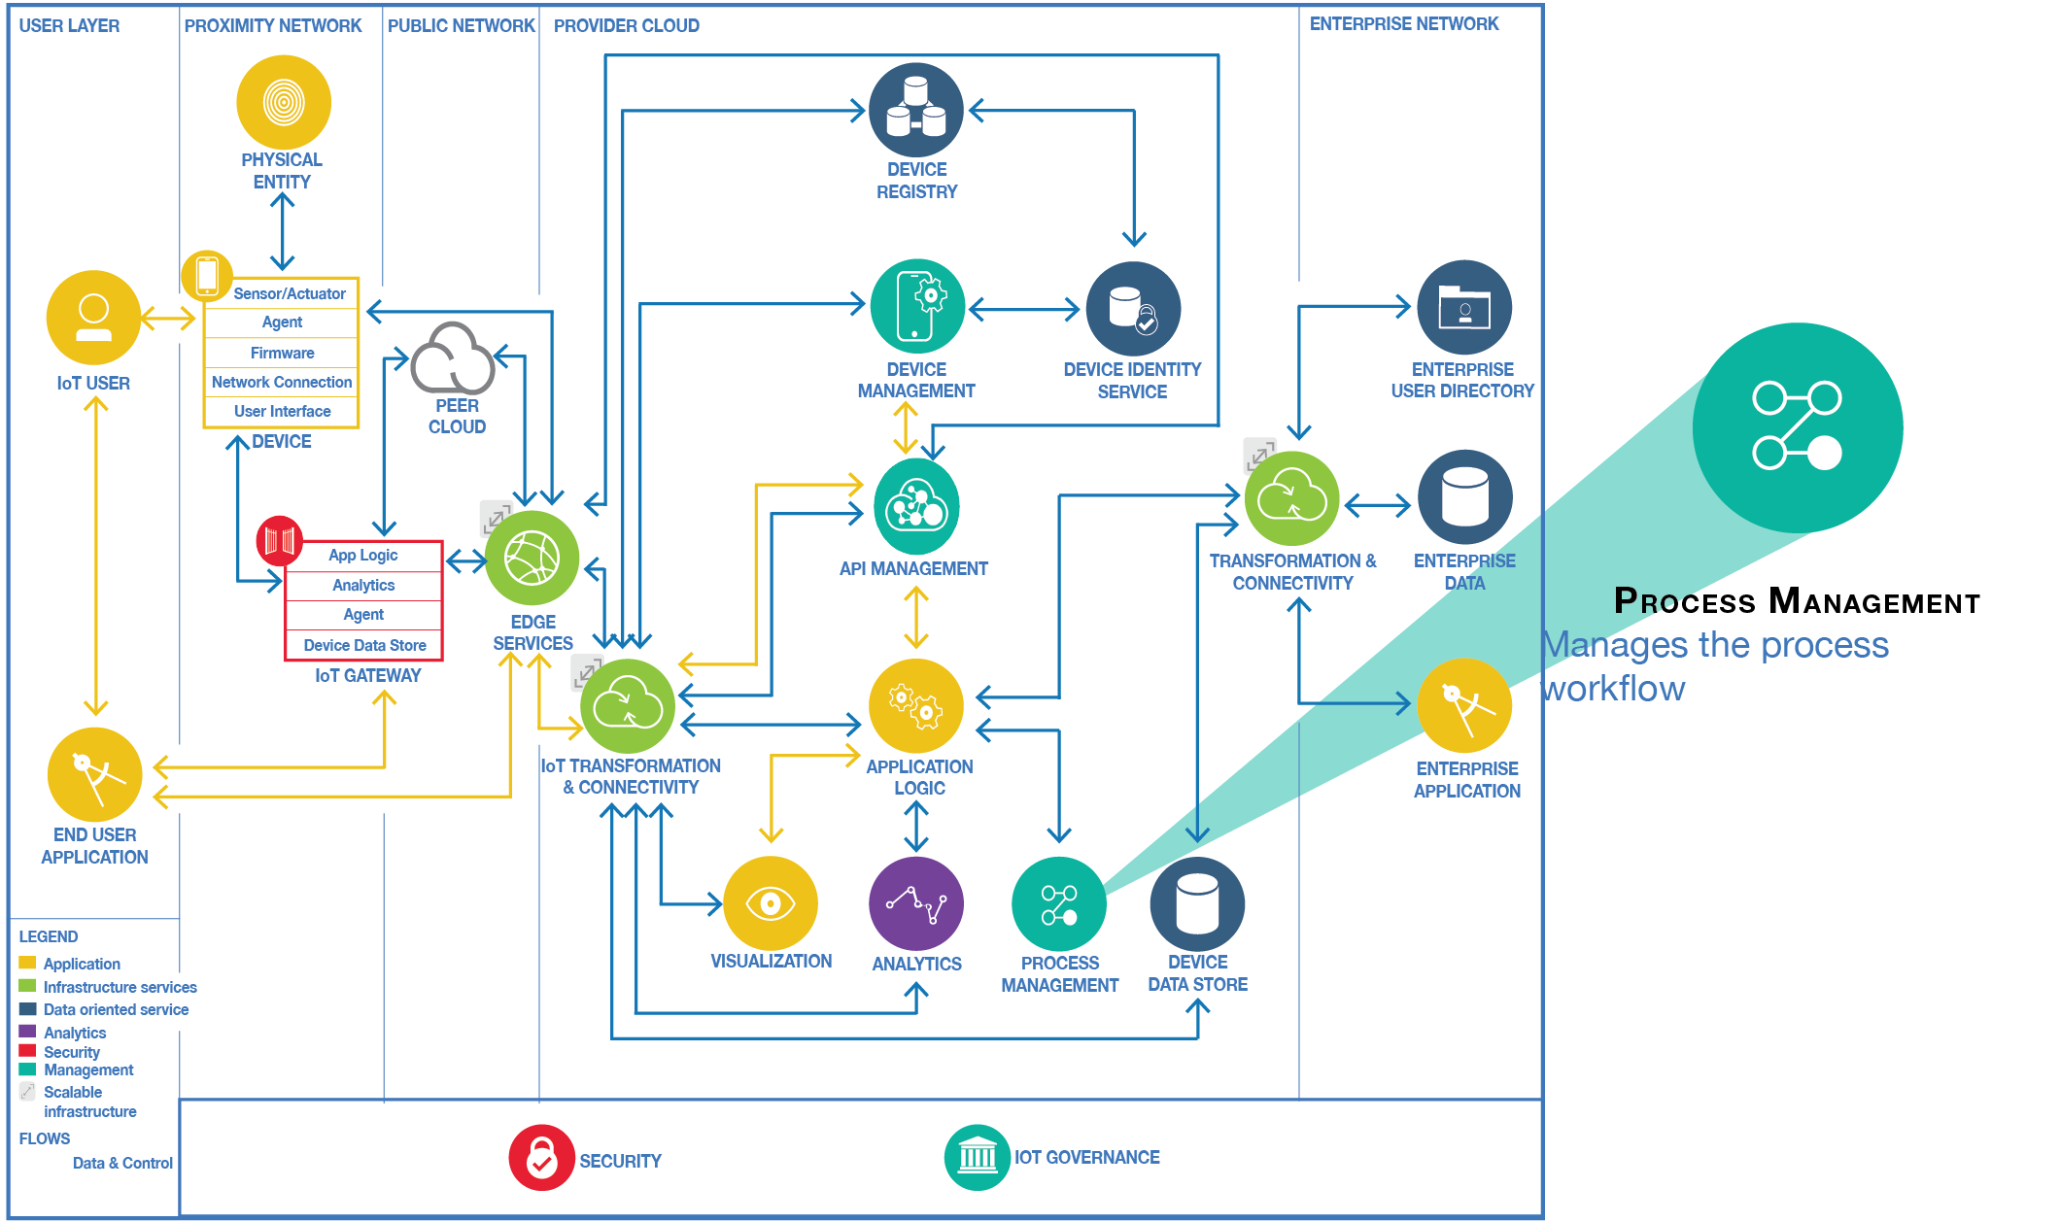

Slide 54
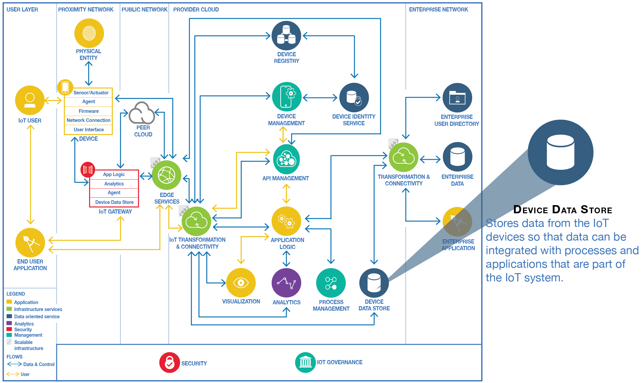

Slide 55
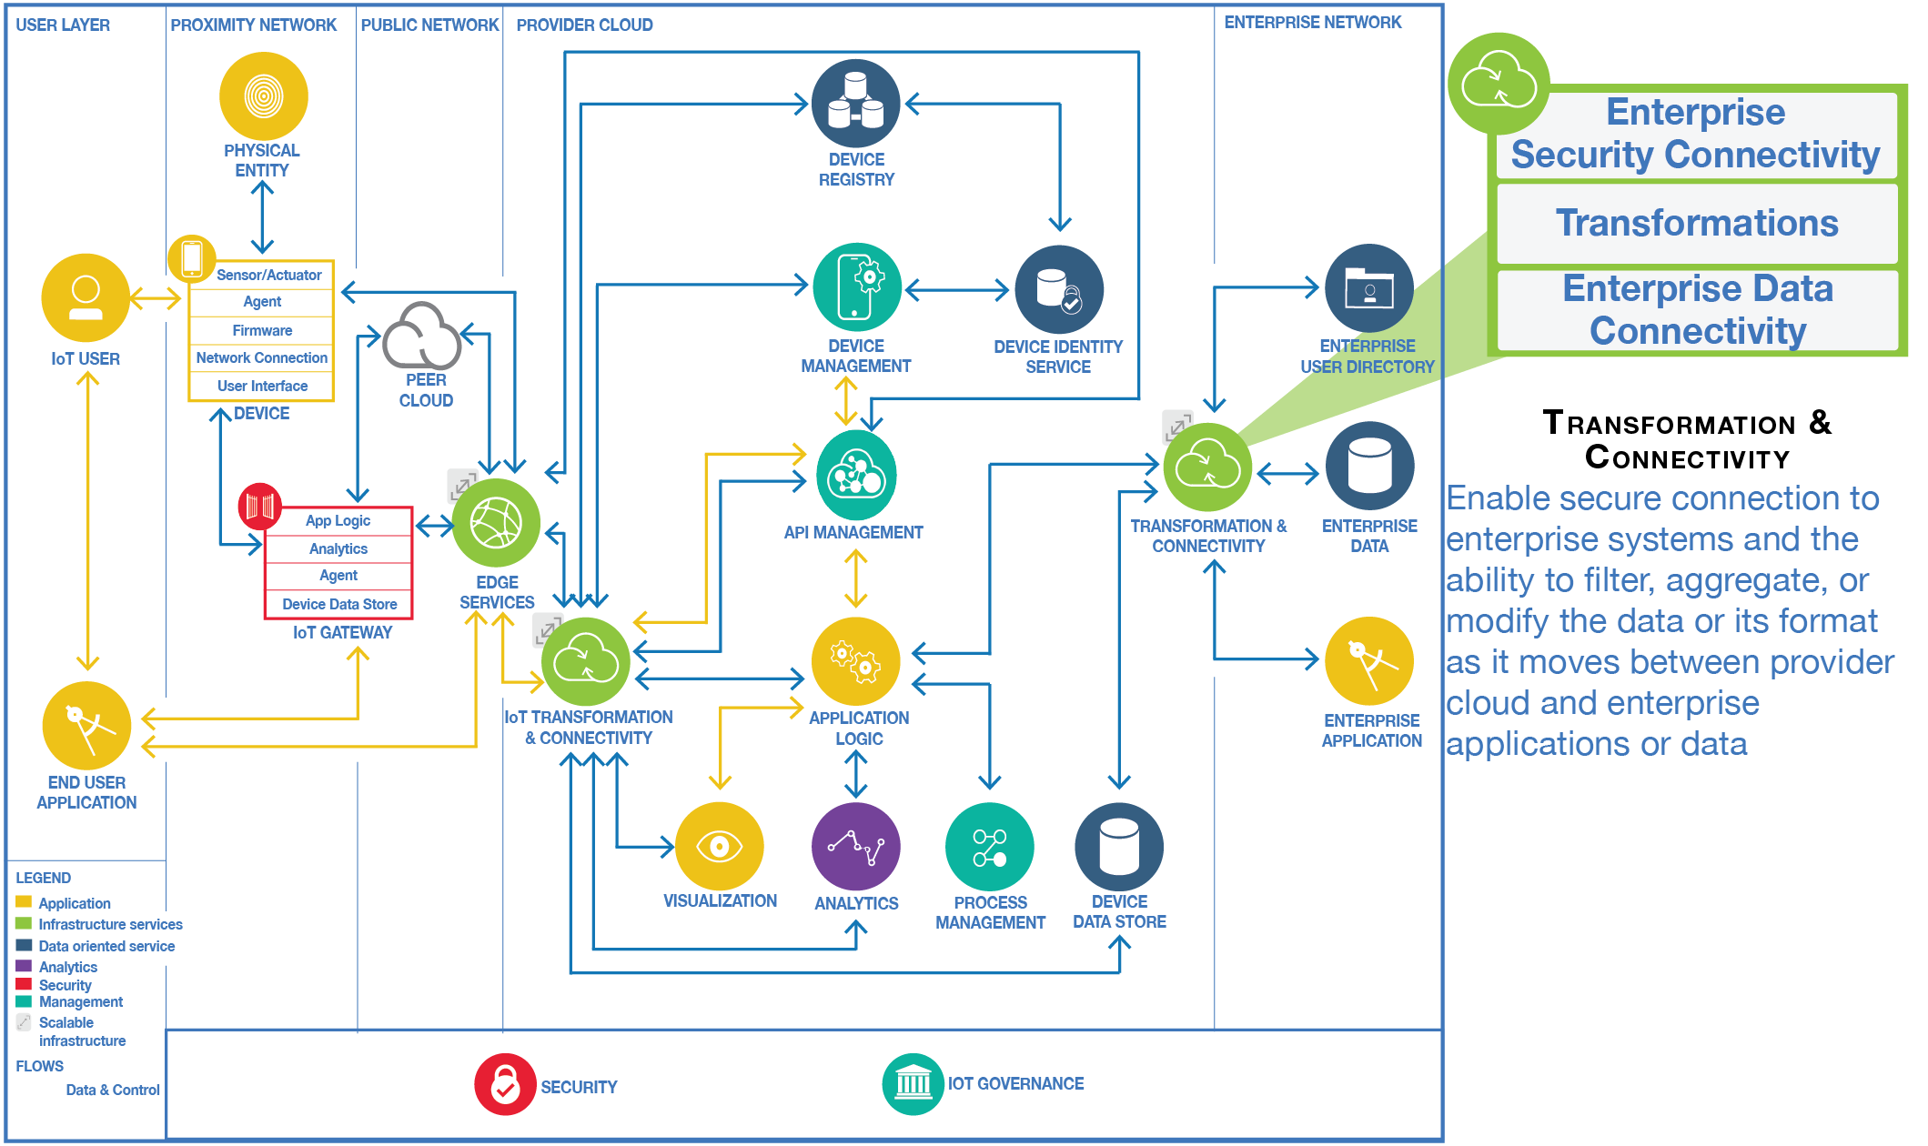

Slide 56
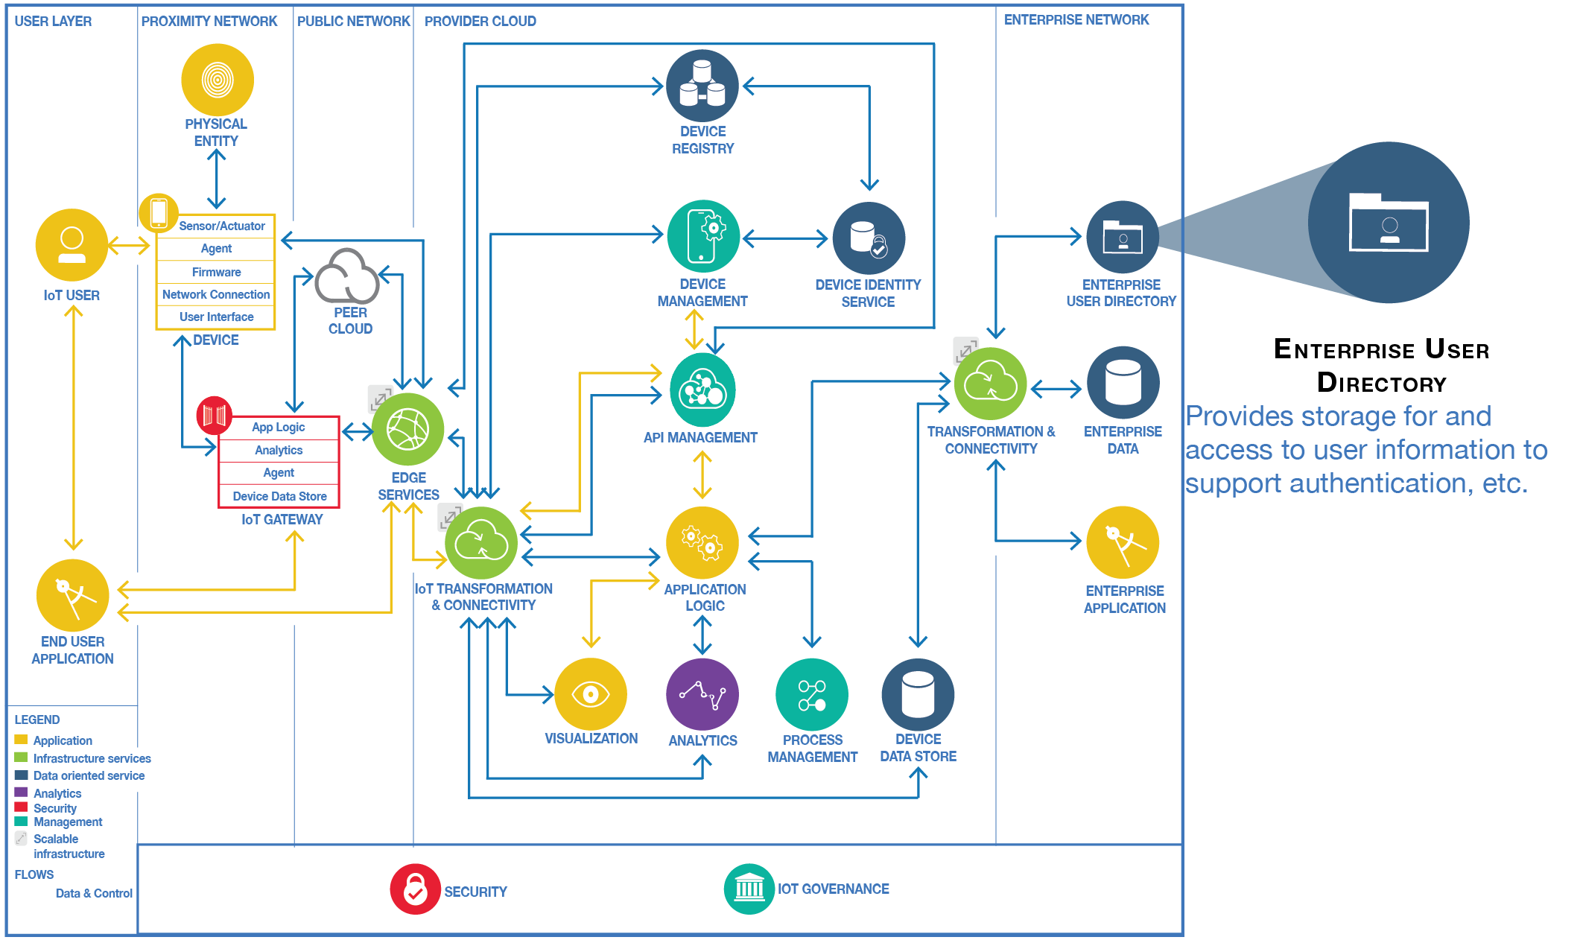

Slide 57
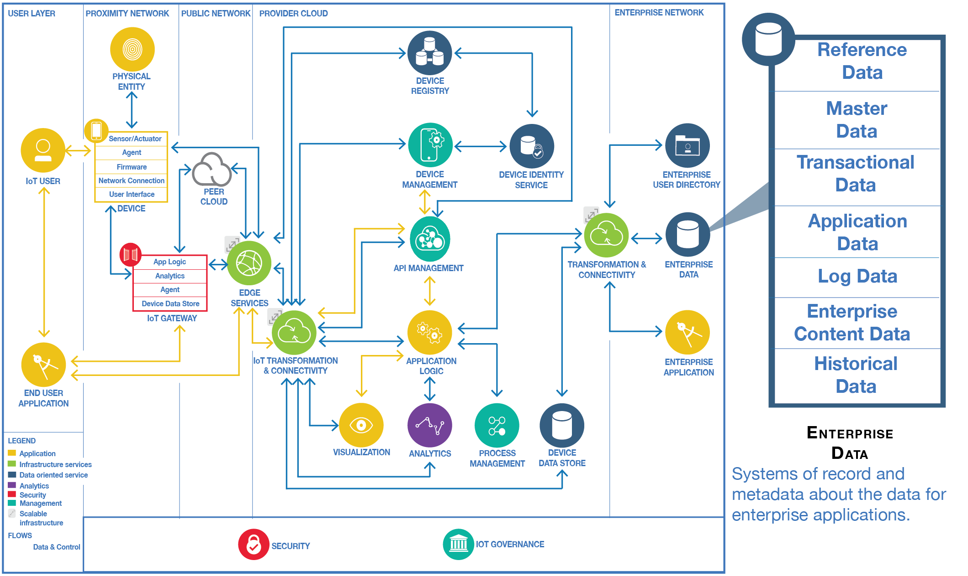

Slide 58
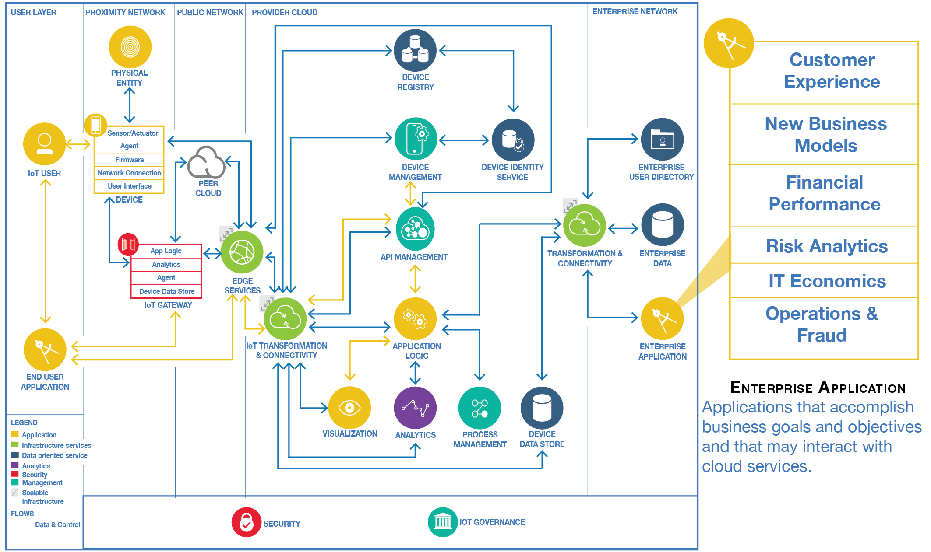

Slide 59
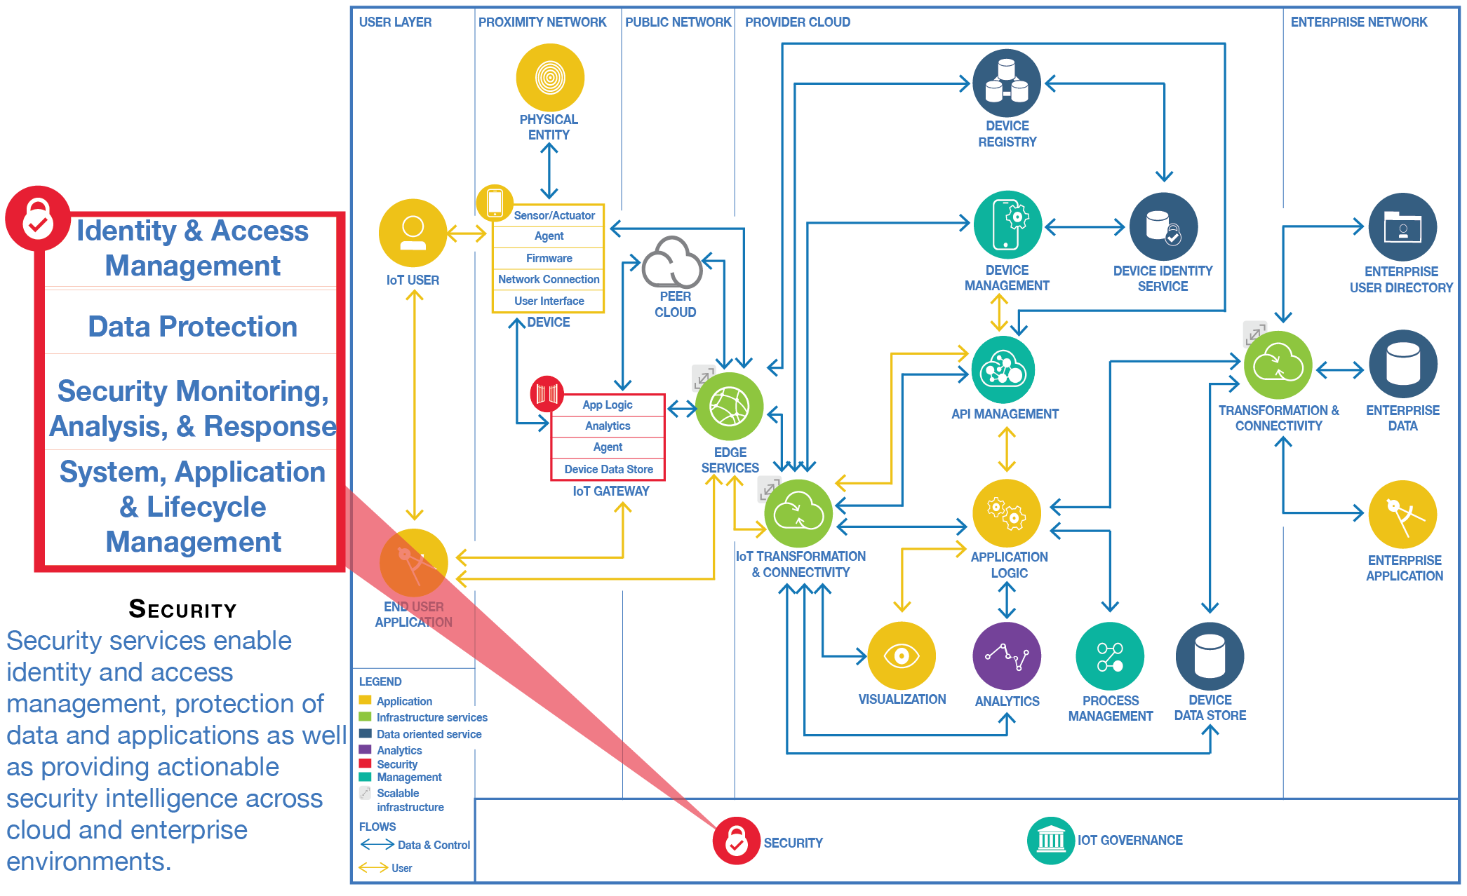

Slide 60
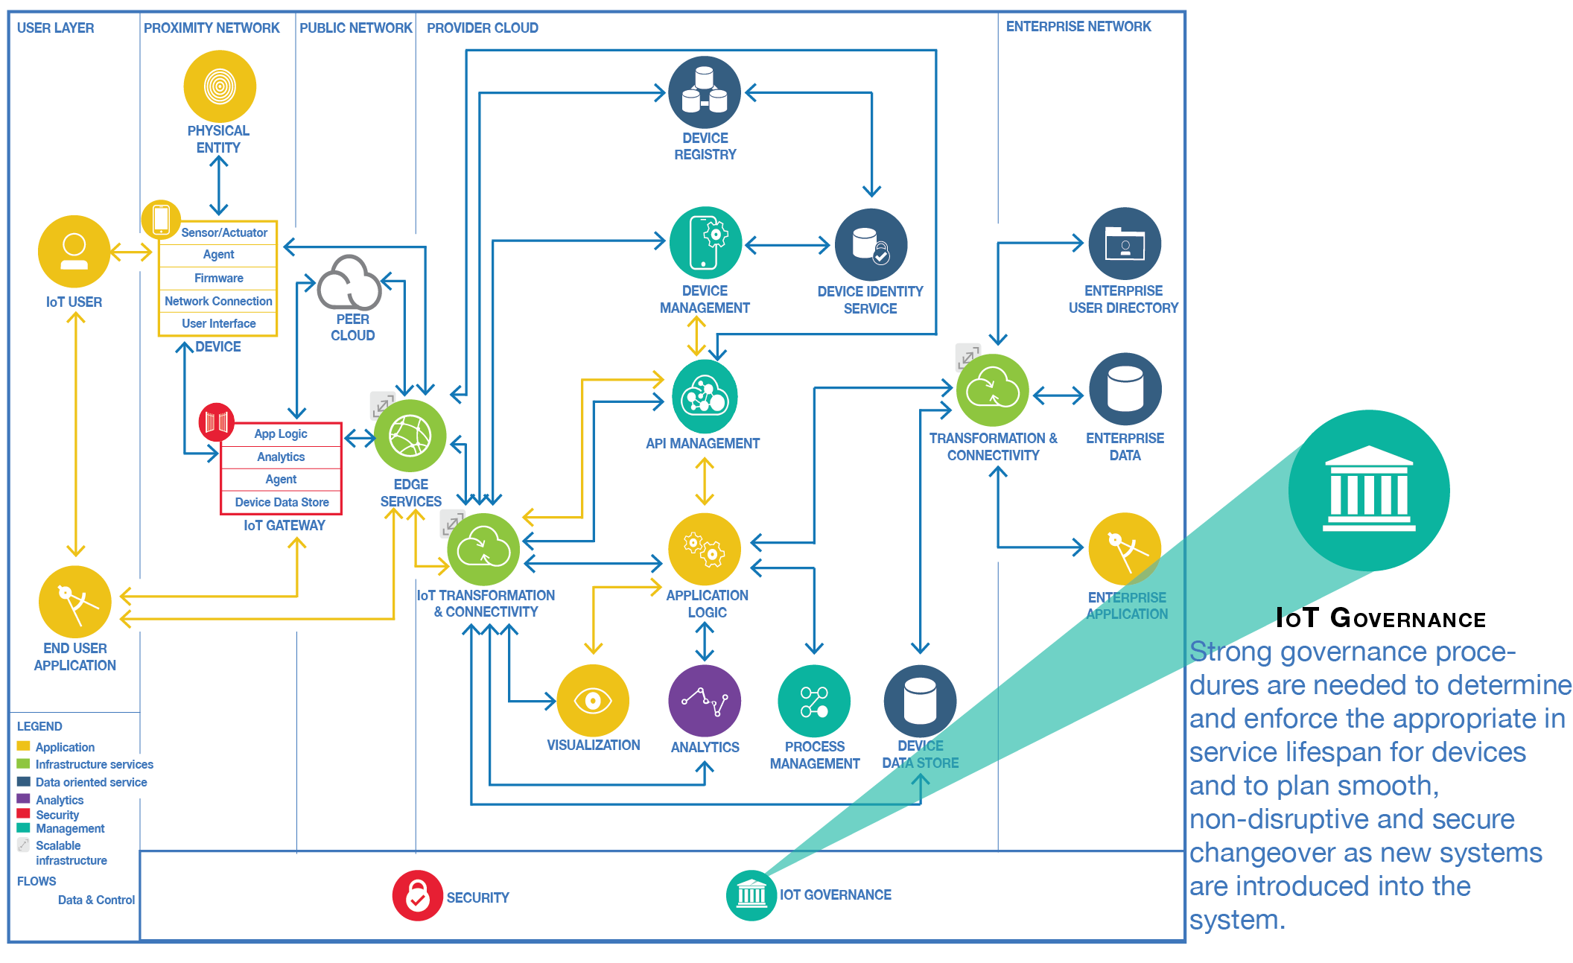

Slide 61
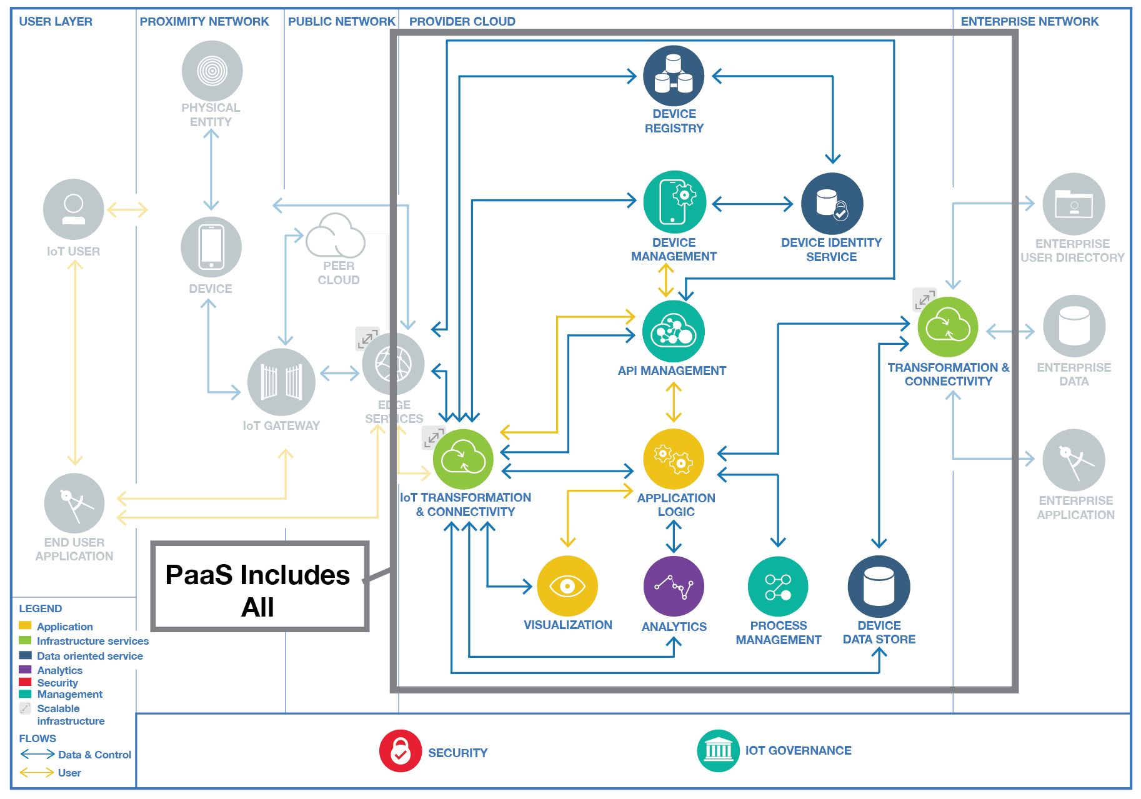

Slide 62
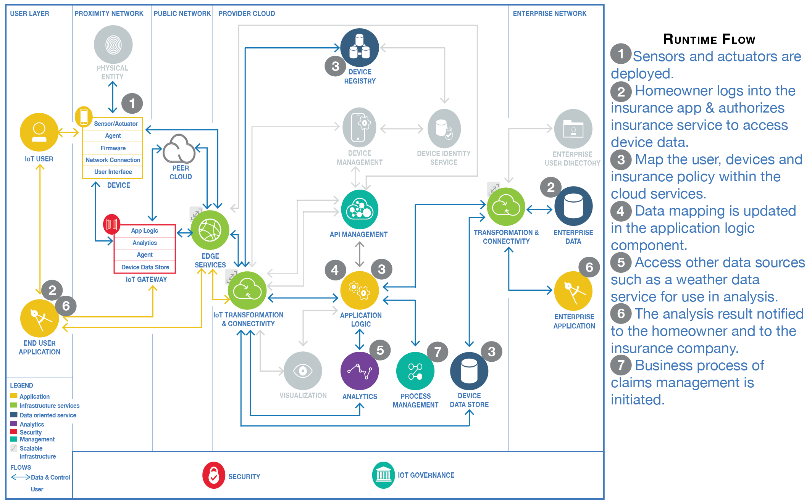

Slide 63
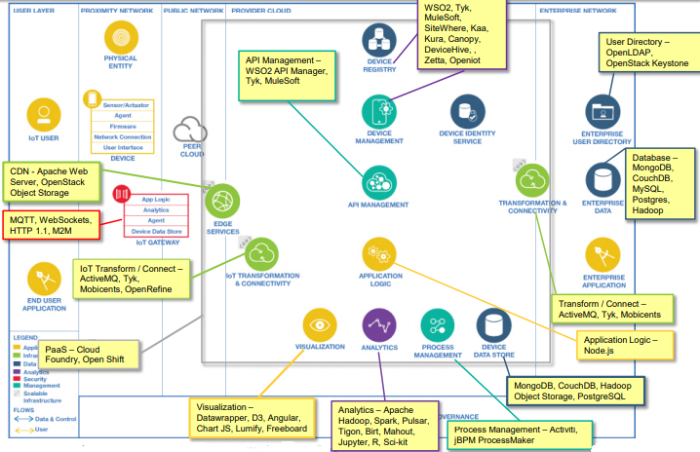

Slide 64
4. Logging on to cloud, Selecting and Creating cloud service
(AWS)

Slide 65
AWS IoT
AWS IoT provides secure, bi-directional communication between Internet-connected devices such as sensors, actuators, embedded micro-controllers, or smart appliances and the AWS Cloud.
This enables you to collect telemetry data from multiple devices, and store and analyze the data.
It creates an applications that enable users to control these devices from their phones or tablets.

Slide 66
AWS IoT Components
Device Gateway
Message Broker
Rules Engine
Security and Identity Service
Registry
Group Registry
Device Shadow
Device Shadow Service
Device Provisioning service
Custom Authentication service
Jobs Service

Slide 67
Accessing AWS IoT
AWS Command Line Interface (AWS CLI)
AWS IoT API
AWS SDKs
AWS IoT Device SDKs

Slide 68
Accessing AWS IoT
AWS Command Line Interface (AWS CLI)
AWS IoT API
AWS SDKs
AWS IoT Device SDKs

Slide 69
AWS Services
Amazon Simple Storage Service—Provides scalable storage in the AWS Cloud. Amazon DynamoDB—Provides managed NoSQL databases.
Amazon Kinesis—Enables real-time processing of streaming data at a massive scale.
AWS Lambda—Runs your code on virtual servers from Amazon EC2 in response to events.
Amazon Simple Notification Service—Sends or receives notifications.
Amazon Simple Queue Service—Stores data

Slide 70
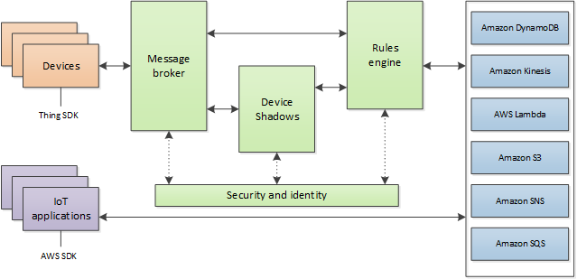
AWS IOT Architecture

Slide 71
To create an AWS account:
Open the AWS home page and choose Create an AWS Account.
Follow the online instructions. Part of the sign-up procedure involves receiving a phone call and entering a PIN using your phone's keypad.
Sign in to the AWS Management Console and open the AWS IoT console.
On the Welcome page, choose Get started.
Register a Device in the Registry

Slide 72
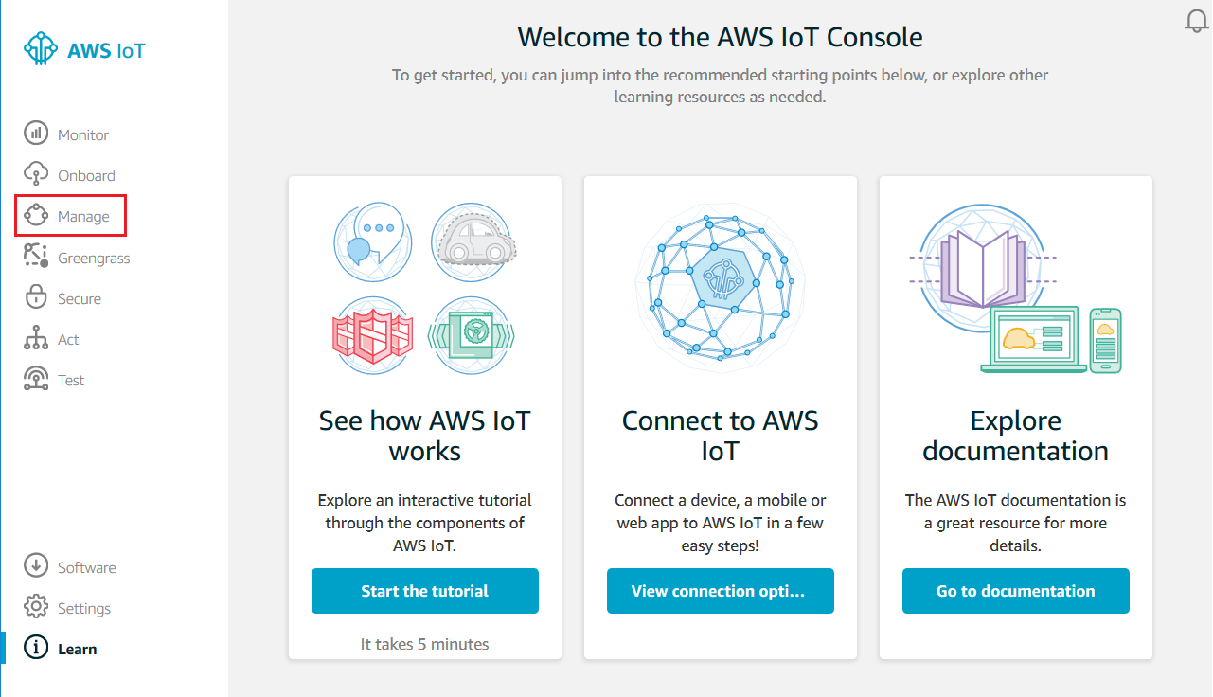
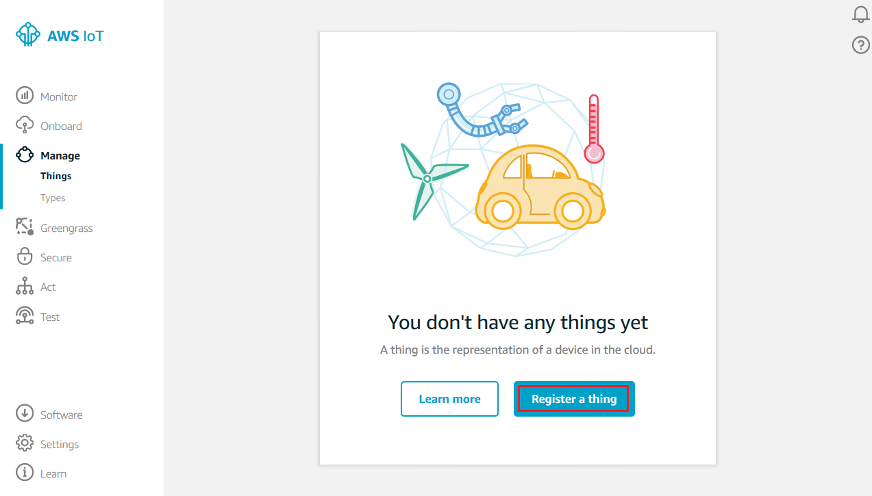
Creation and Registering

Slide 73
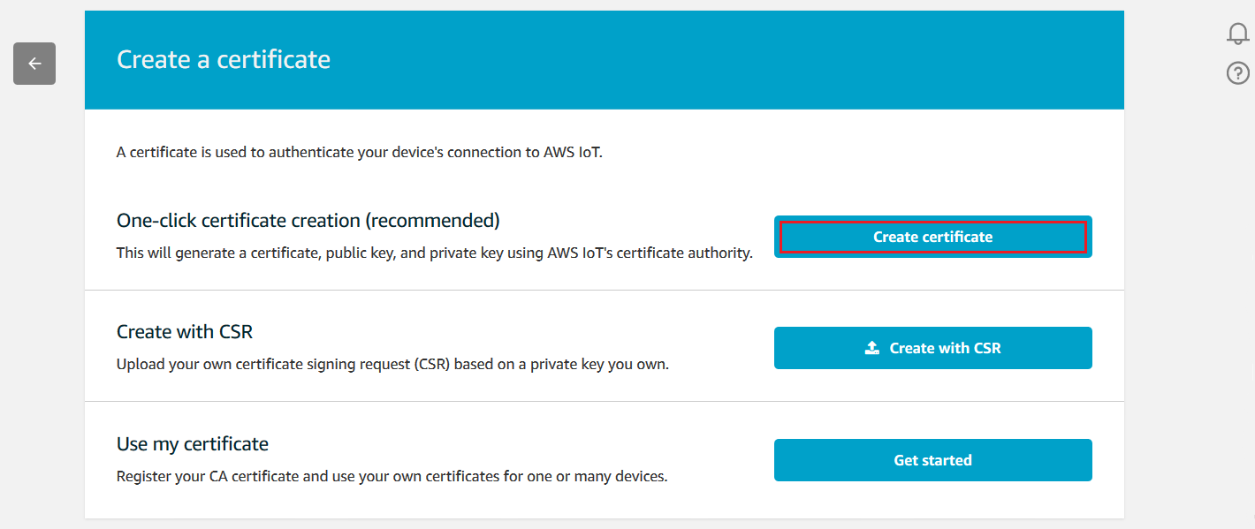
Certificate Activation

Slide 74
Creation of Policy
In the left navigation pane, choose Secure, and then Policies. On the You don't have a policy yet page, choose Create a policy.
On the Create a policy page, in the Name field, type a name for the policy (for example,MyIoTButtonPolicy). In the Action field, type iot:Connect. In the Resource ARN field, type *. Select the Allow checkbox. This allows all clients to connect to AWS IoT.

Slide 75
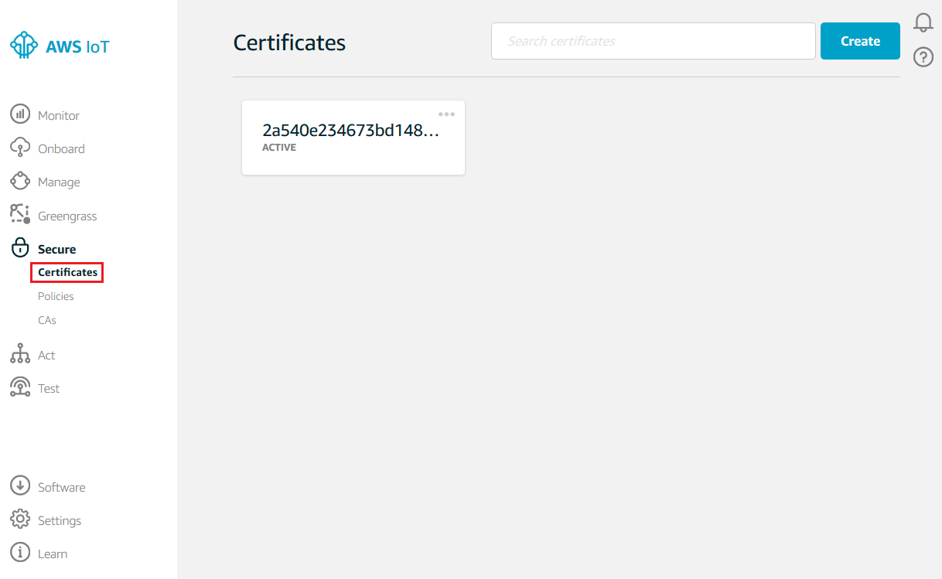
Attach an AWS IoT Policy to a Device Certificate

Slide 76
Attach a Certificate to a Thing
In the box for the certificate you created, choose ... to open a drop-down menu, and then choose Attach thing.
In the Attach things to certificate(s) dialog box, select the check box next to the thing you registered, and then choose Attach.
To verify the thing is attached, select the box representing the certificate.
On the Details page for the certificate, in the left navigation pane, choose Things.
To verify the policy is attached, on the Details page for the certificate, in the left navigation pane, choose Policies.

Slide 77
Configure Your Device and Button
Turn on your device
Configure a Different Device
Configure and Test Rules

Slide 78
5. Cloud Based IoT Platforms

Slide 79
IBM Watson
Google cloud

Slide 80
IBM Watson IoT Platform
It is a fully managed, cloud-hosted service designed to make it simple to derive value from Internet of Things devices.
It provides capabilities such as device registration, connectivity, control, rapid visualization and storage of Internet of Things data.

Slide 81
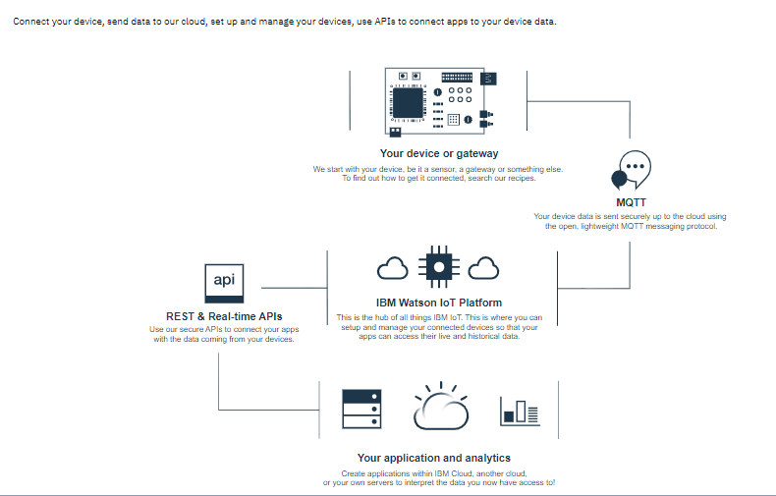

Slide 82
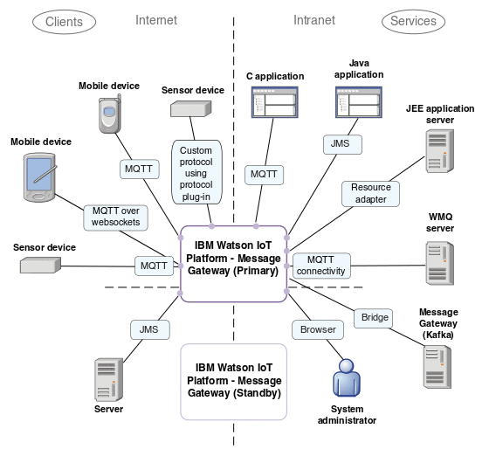

Slide 83
Features
Real-time data exchange
Secure Communication
Cognitive systems
Recently added data sensor and weather data service

Slide 84
Pros
Process untapped data
Handle huge quantities of data
Improve customer services
Cons
Need a lot of maintenance.
Take time for Watson integration
High switching cost.

Slide 85
Google Cloud’s IoT Platform
Google Cloud Platform is a set of Computing, Networking, Storage, Big Data, and Machine Learning and Management services provided by Google that runs on the same Cloud infrastructure that Google uses internally for its end-user products, such as Google Search, Gmail, Google Photos and YouTube.

Slide 86
Features
Provides huge storage
Cuts cost for server maintenance
Business through a fully protected, intelligent, and responsive IoT data
Efficient and scalable
Analyze big data
IoT is helping businesses gain new revenue and new intelligence
Tools available for all IoT applications

Slide 87
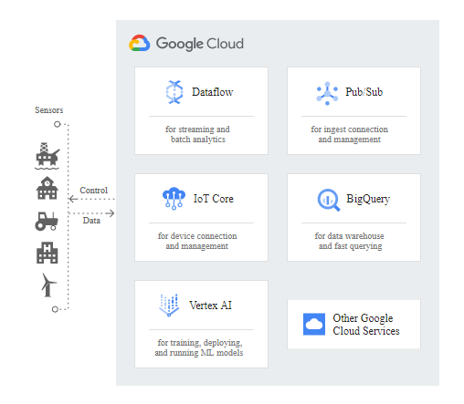

Slide 88
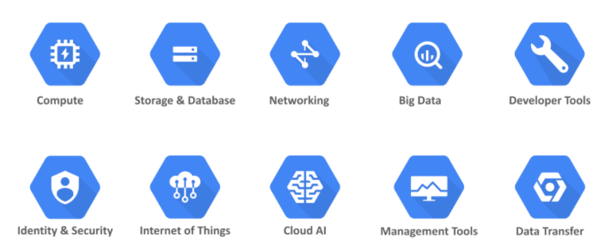
Services Offered by Google Cloud

Slide 89
Pros
Fastest input/output
Lesser access time
Provides integration with other Google services
Cons
Most of the components are Google technologies
Limited programming language choices

Slide 90
End

